Slide 1
딥러닝의 이해 II
2023. 2. 2
김 형 오

Slide 2
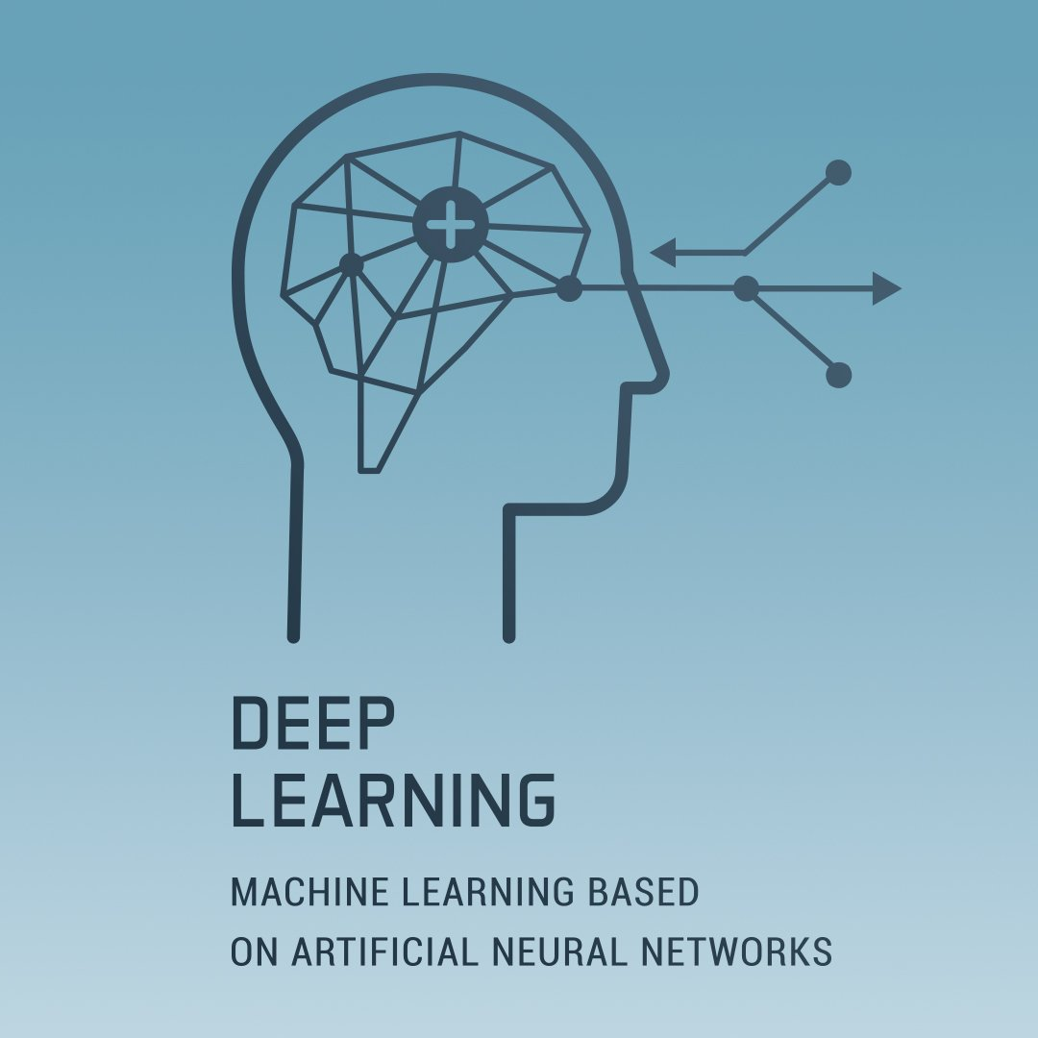
딥러닝의 이해 II

Slide 3
목차
A table of Contents
#1,
NLP
#2,
RNN
#3,
Attention
#4,
Transformer

Slide 4

Part 1,
NLP
참고문헌 :
Basics and Applications for Transformer, 이영재, 2020.9.4
딥러닝기반 자연어 언어모델 BERT, 김성현, 2019.8.8

Slide 5
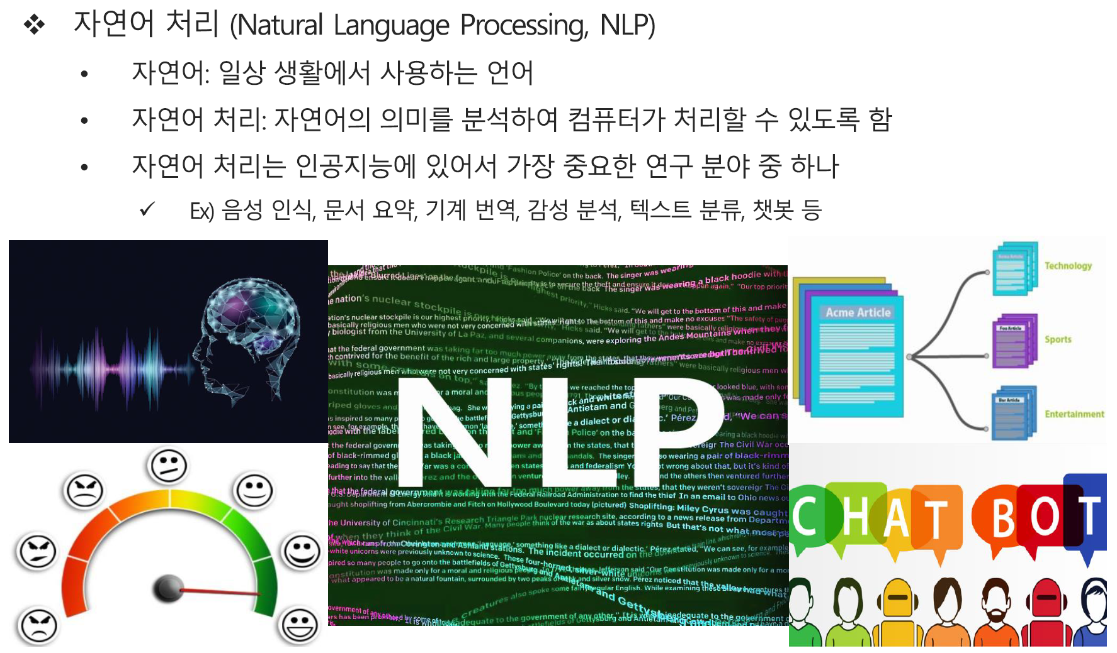
Part 1
자연어 처리

Slide 6
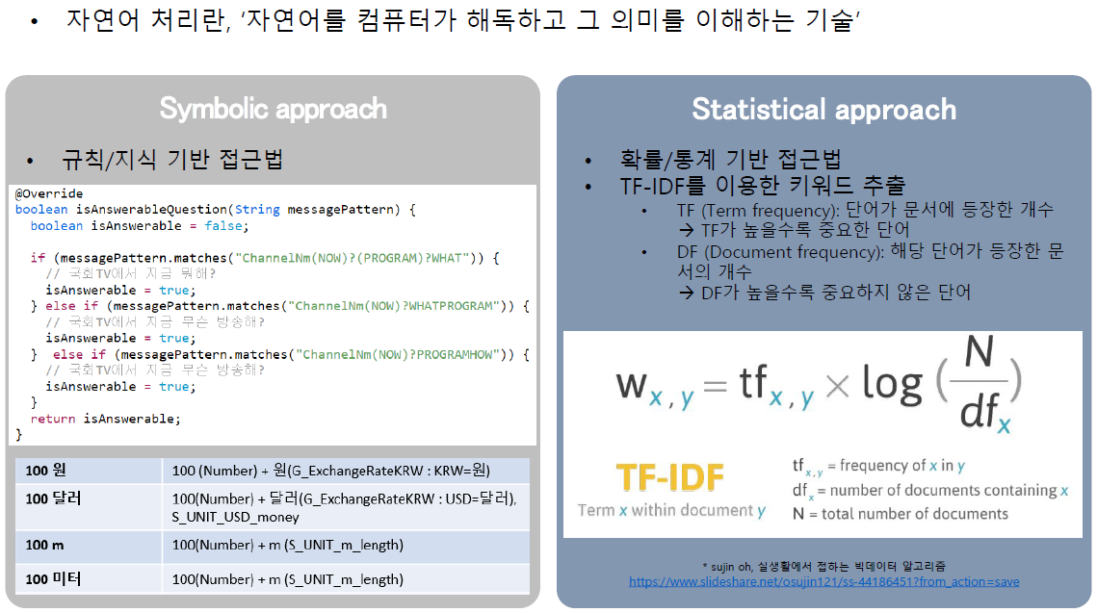
Part 1
자연어 처리

Slide 7
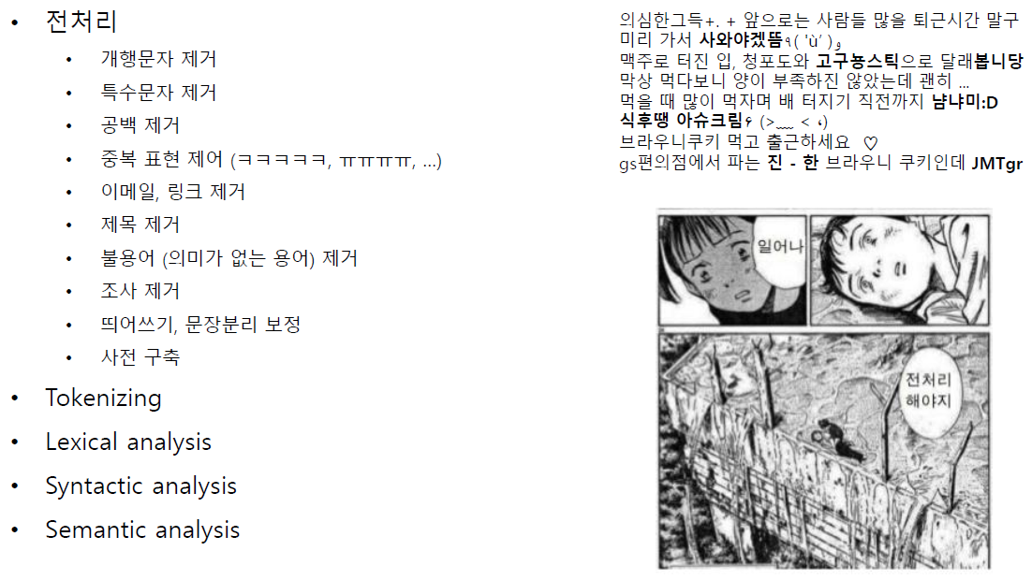
Part 1
자연어 처리 단계

Slide 8
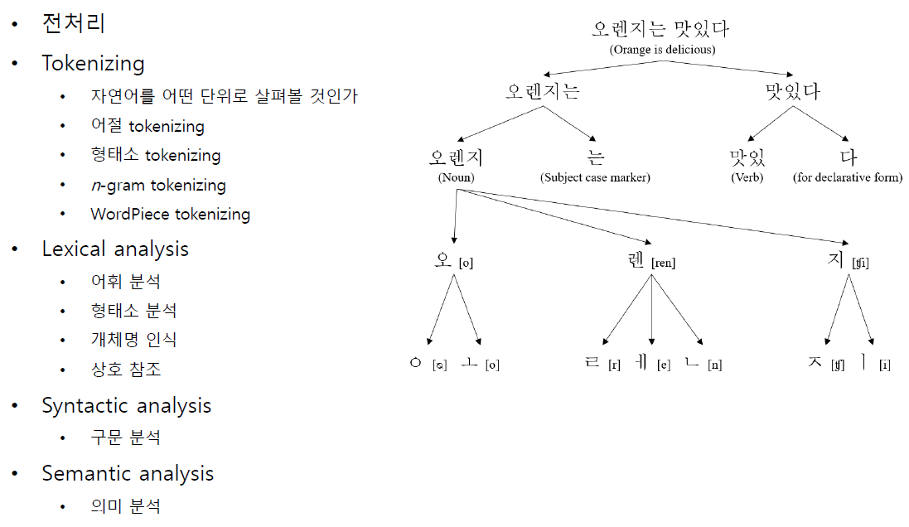
Part 1
자연어 처리 단계

Slide 9
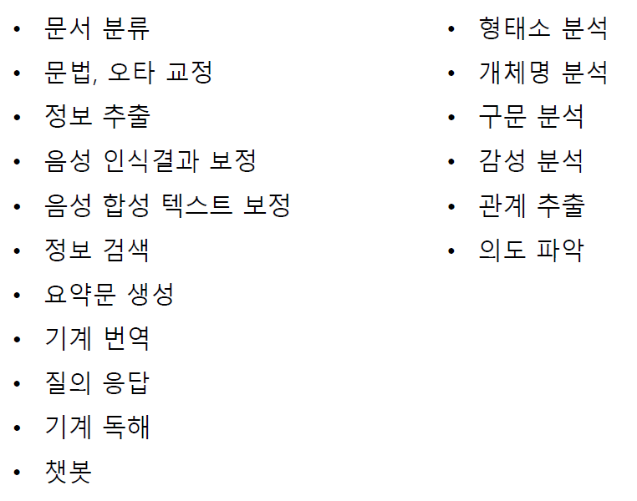
Part 1
자연어 처리 Application

Slide 10
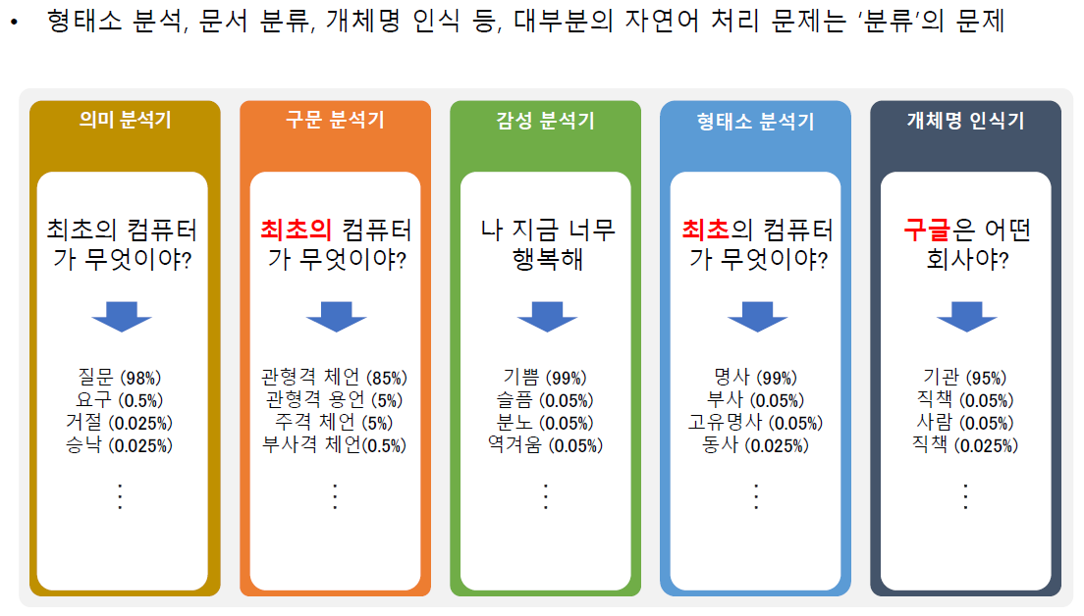
Part 1
자연어 처리 Application

Slide 11
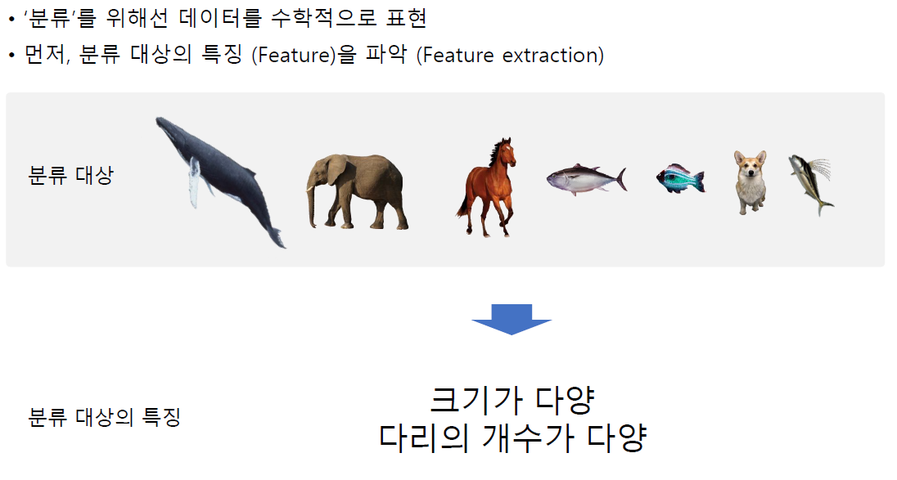
Part 1
특징 추출과 분류

Slide 12
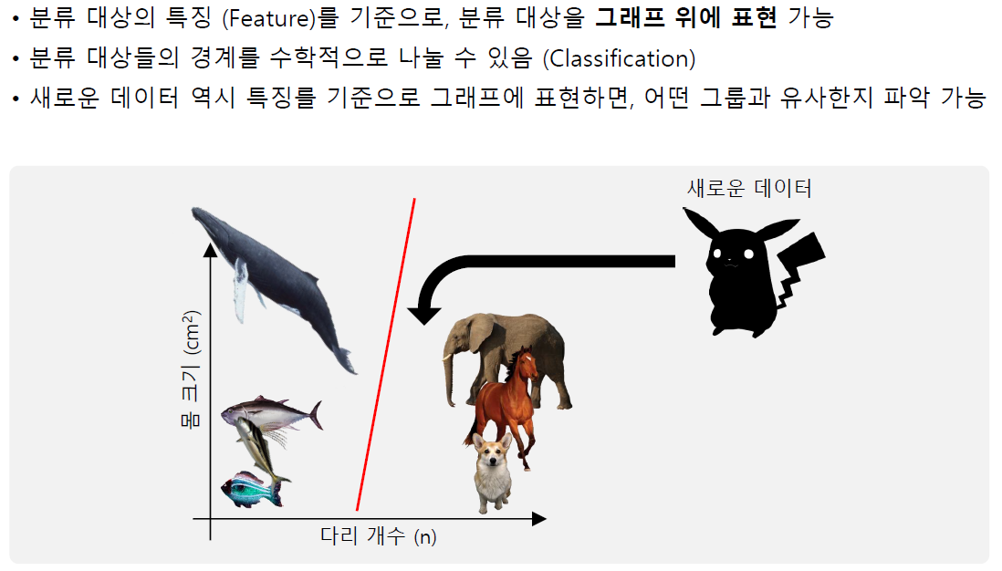
Part 1
특징 추출과 분류

Slide 13
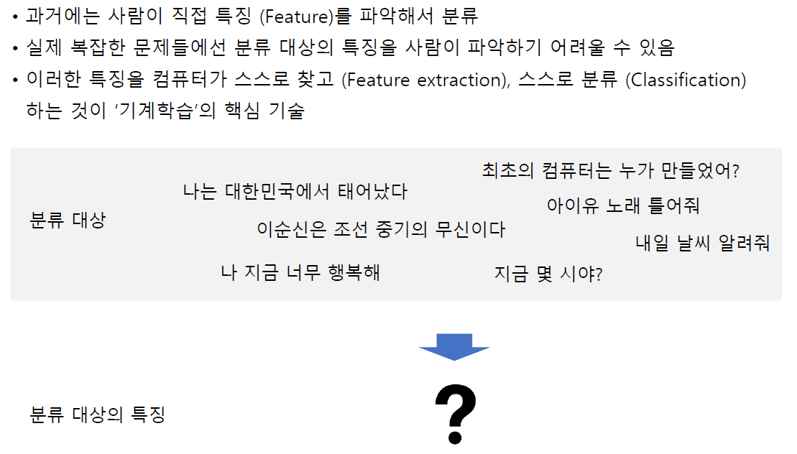
Part 1
자연어 특징 추출과 분류

Slide 14
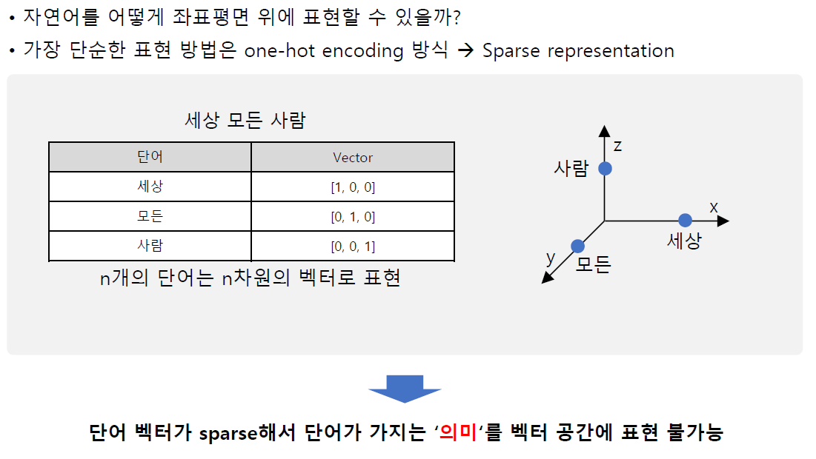
Part 1
Word embedding – One-hot encoding

Slide 15
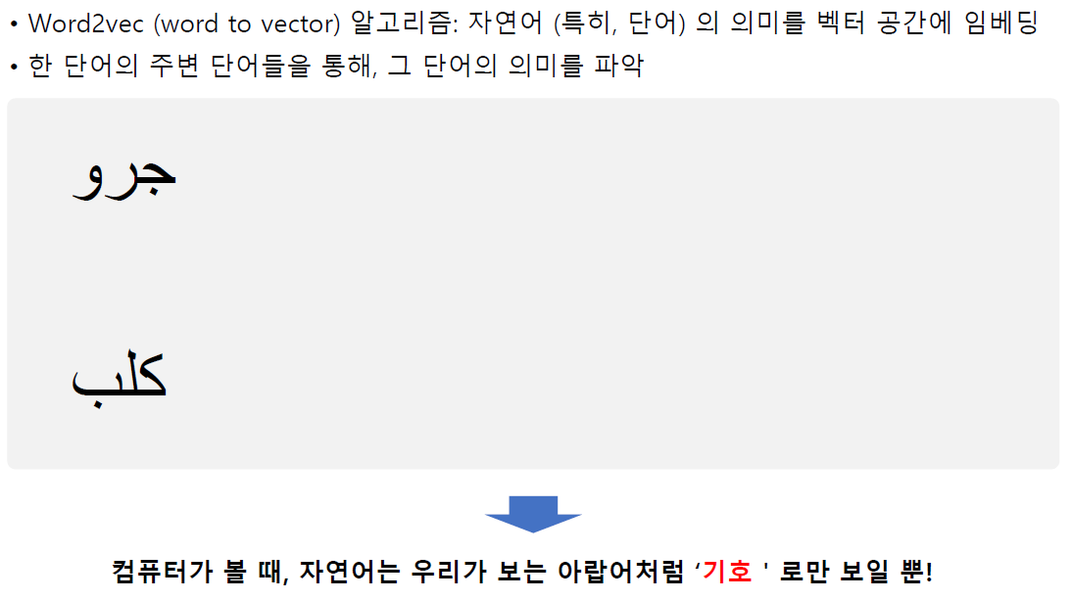
Part 1
Word embedding – Word2Vec

Slide 16
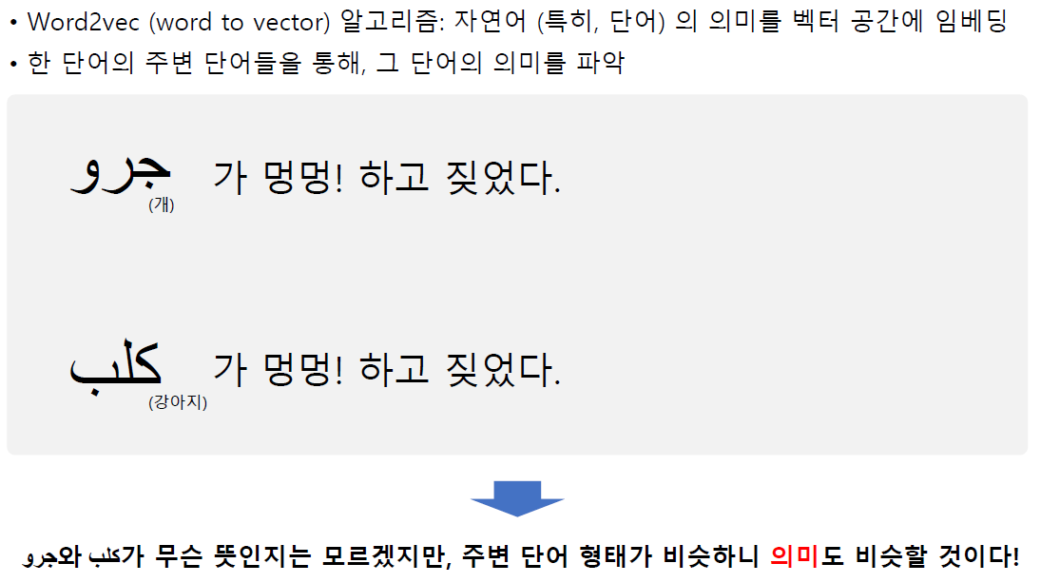
Part 1
Word embedding – Word2Vec

Slide 17
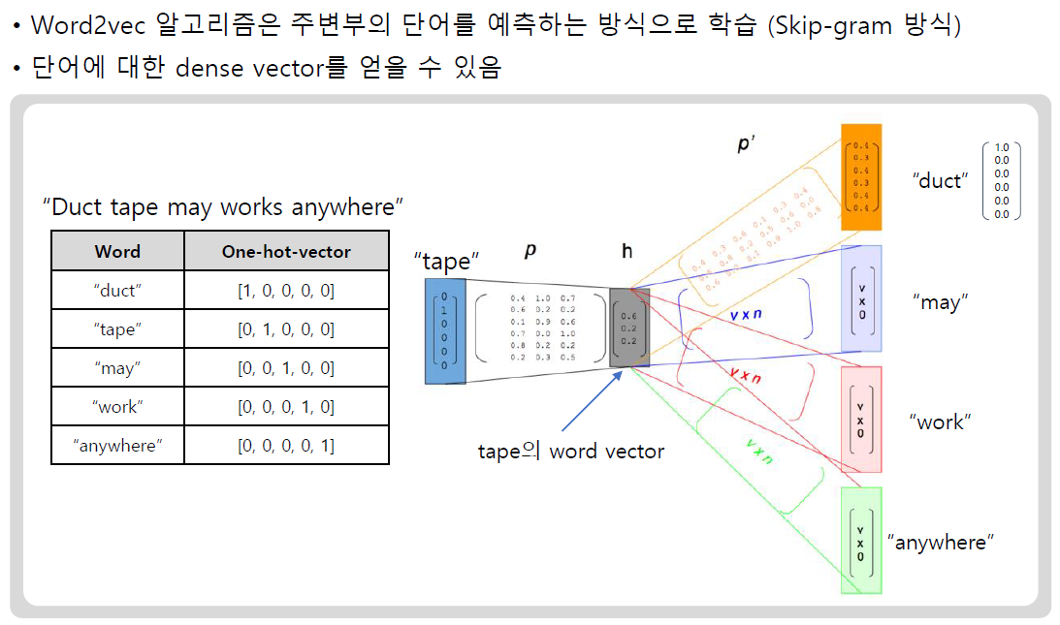
Part 1
Word embedding – Word2Vec

Slide 18
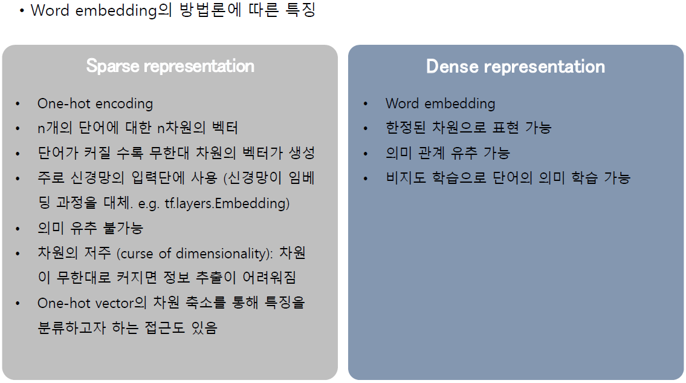
Part 1
Word embedding – Word2Vec

Slide 19
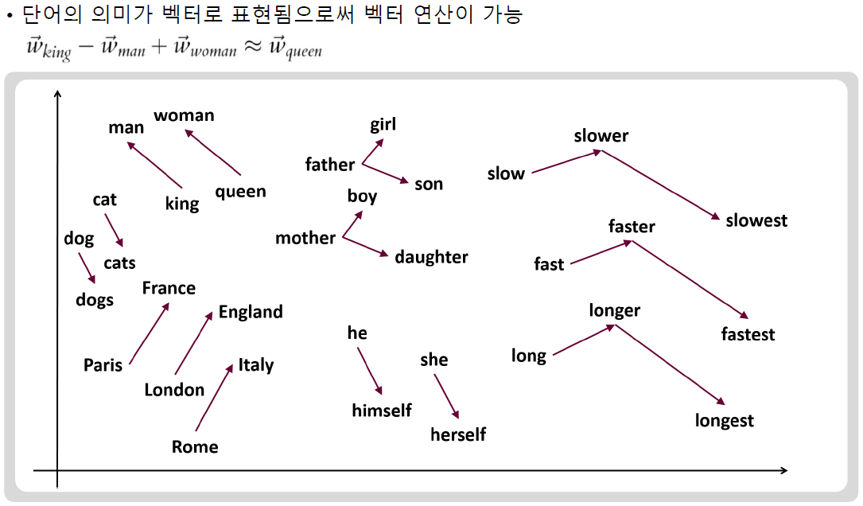
Part 1
Word embedding – Word2Vec

Slide 20
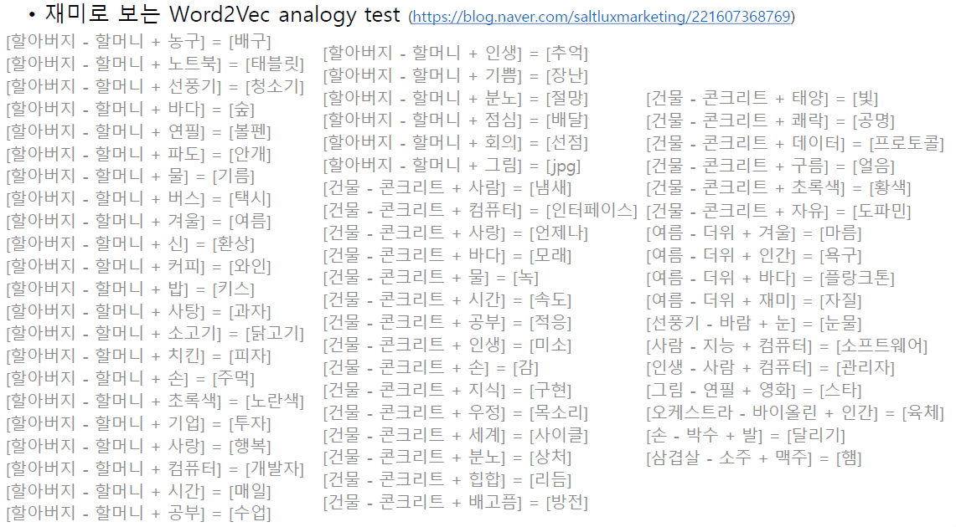
Part 1
Word embedding – Word2Vec

Slide 21
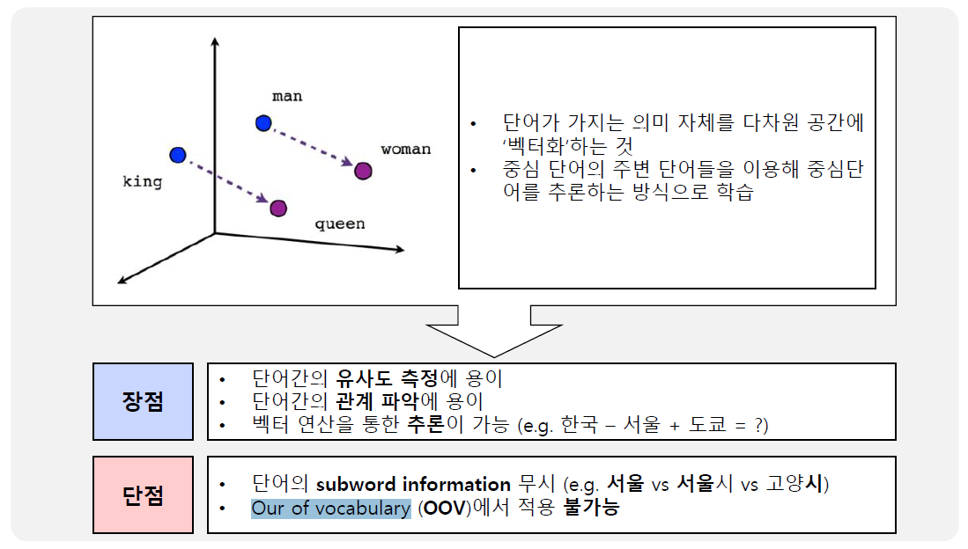
Part 1
Word embedding – Word2Vec

Slide 22
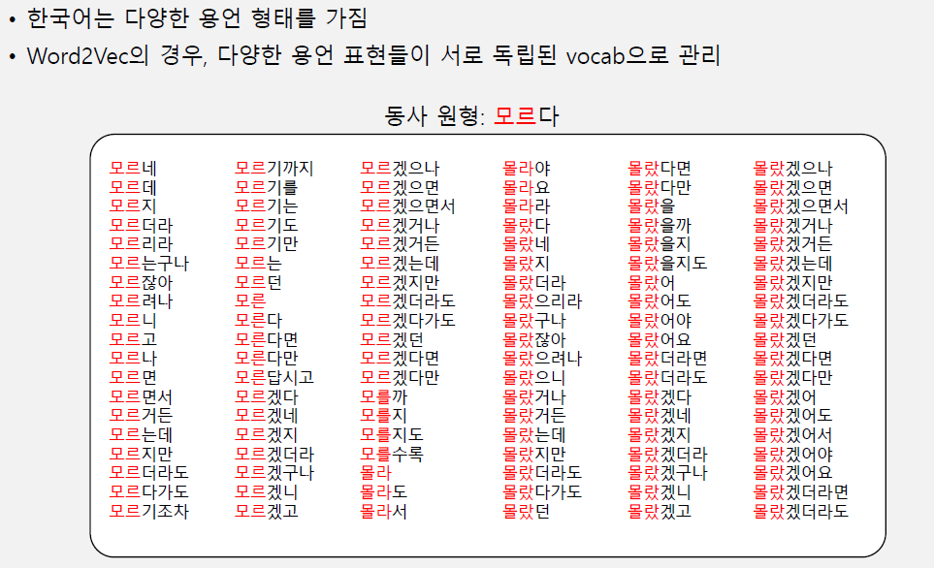
Part 1
Word embedding – FastText

Slide 23
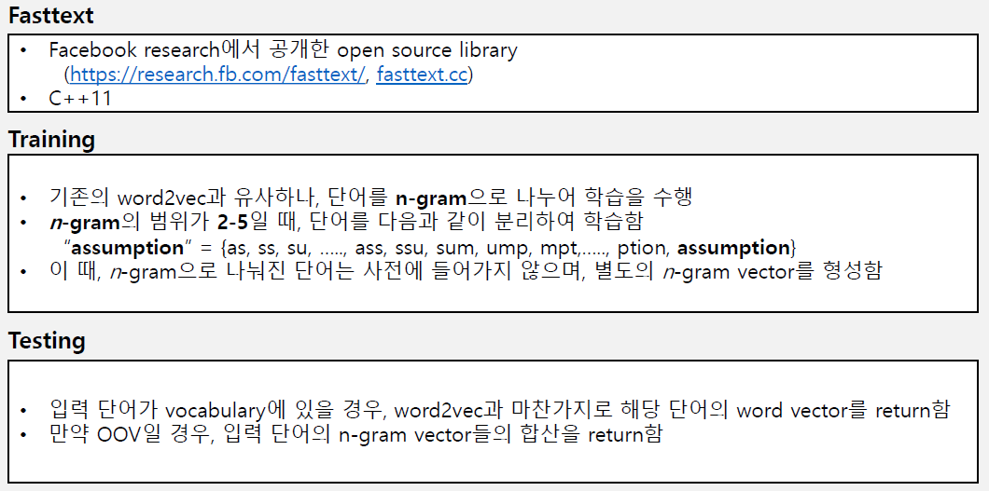
Part 1
Word embedding – FastText

Slide 24
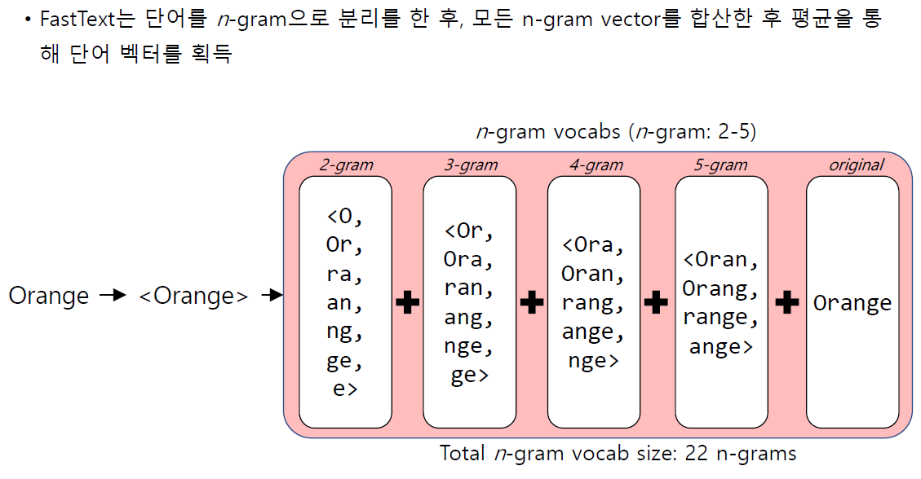
Part 1
Word embedding – FastText

Slide 25
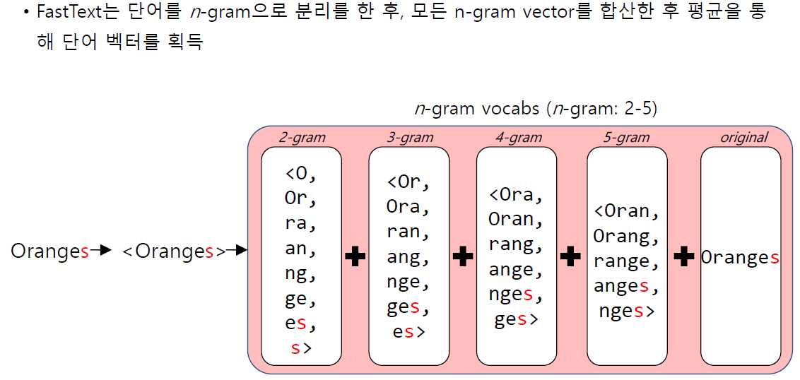
Part 1
Word embedding – FastText

Slide 26
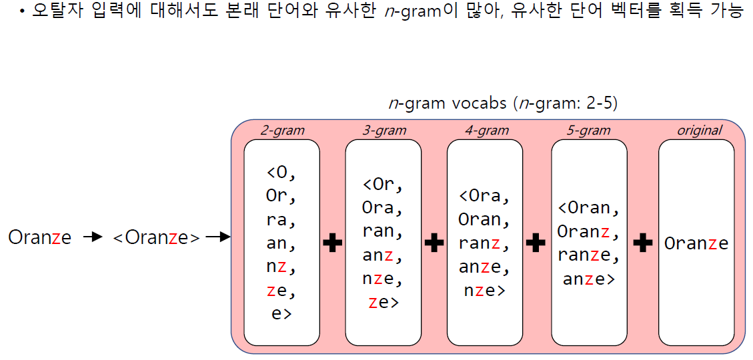
Part 1
Word embedding – FastText

Slide 27
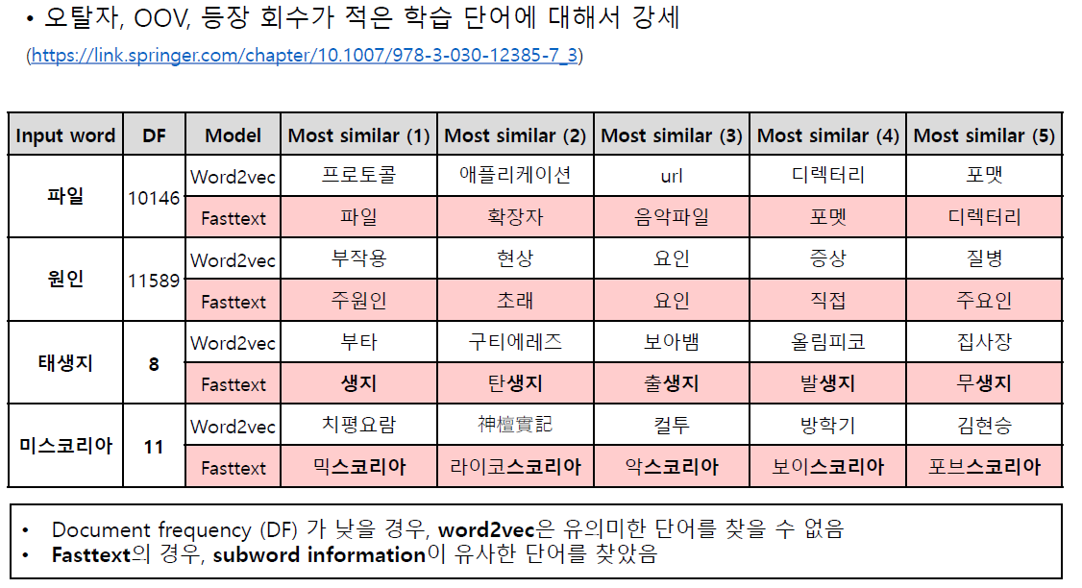
Part 1
FastText와 Word2Vec 비교

Slide 28
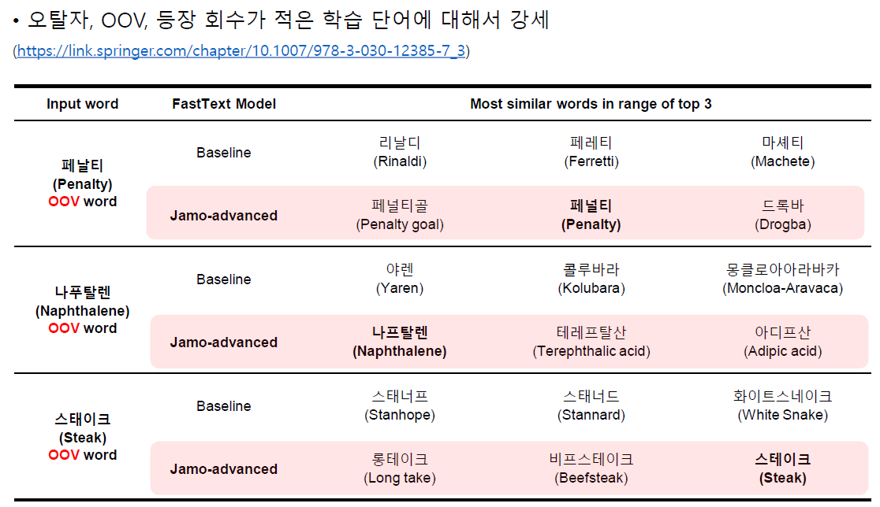
Part 1
Advanced FastText 모델

Slide 29
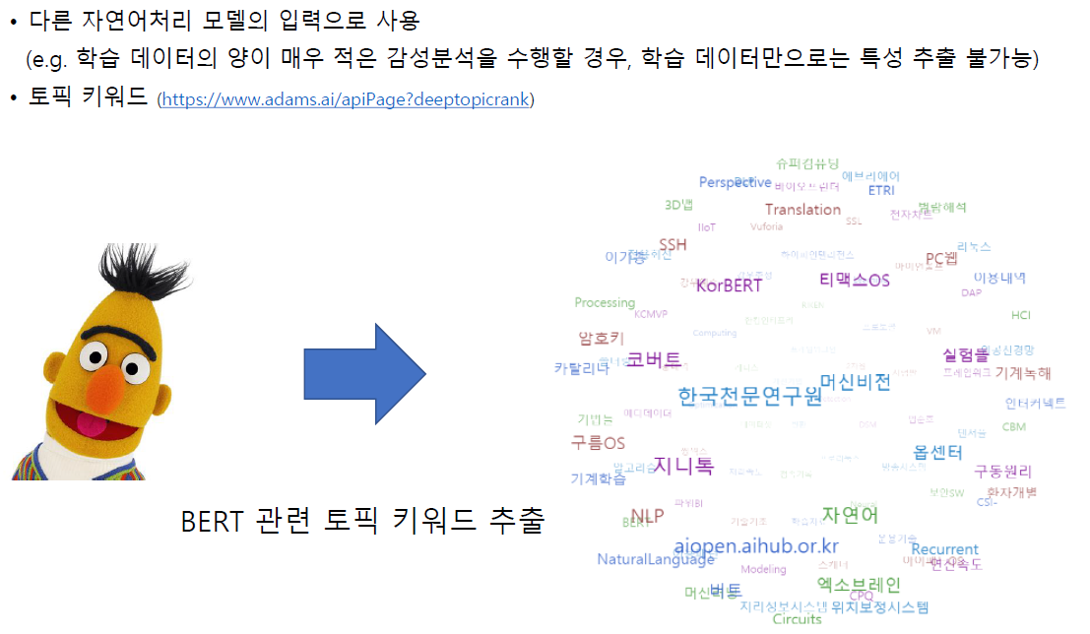
Part 1
Word embedding 의 활용

Slide 30
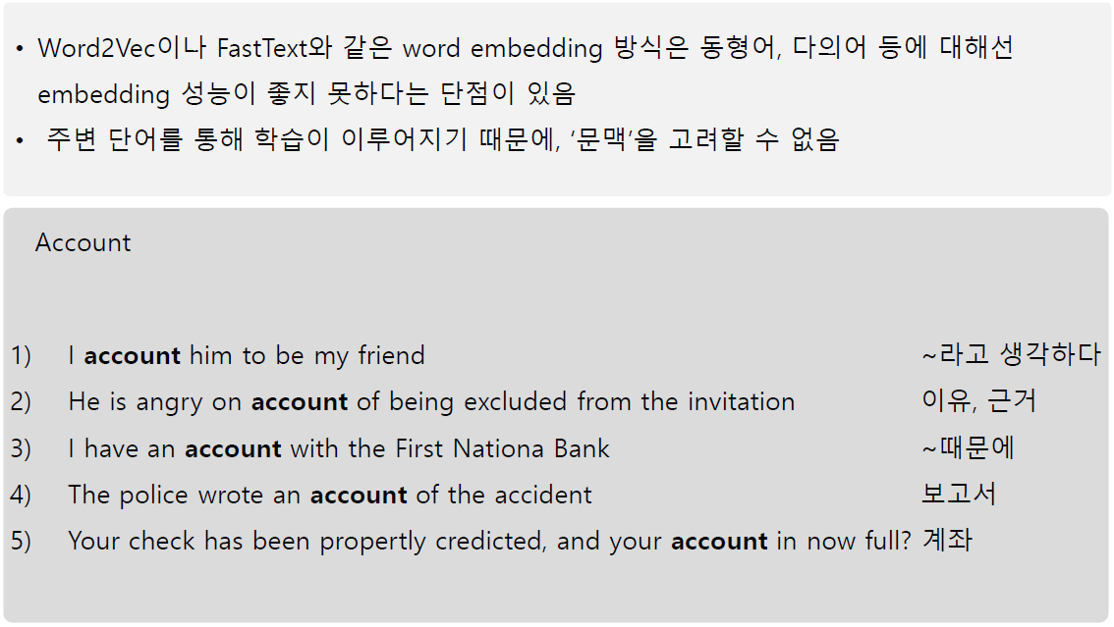
Part 1
Word embedding 의 한계점

Slide 31
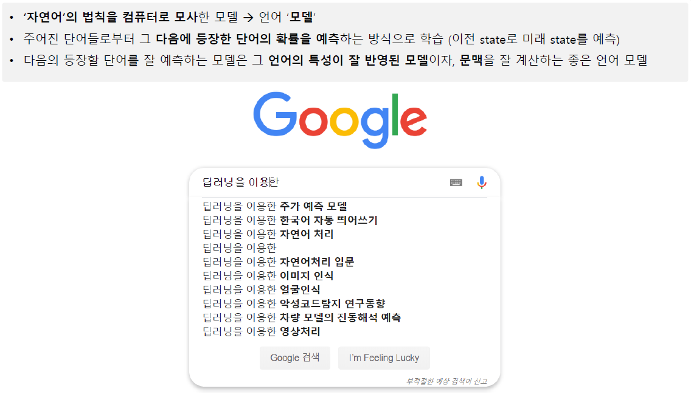
Part 1
언어모델

Slide 32
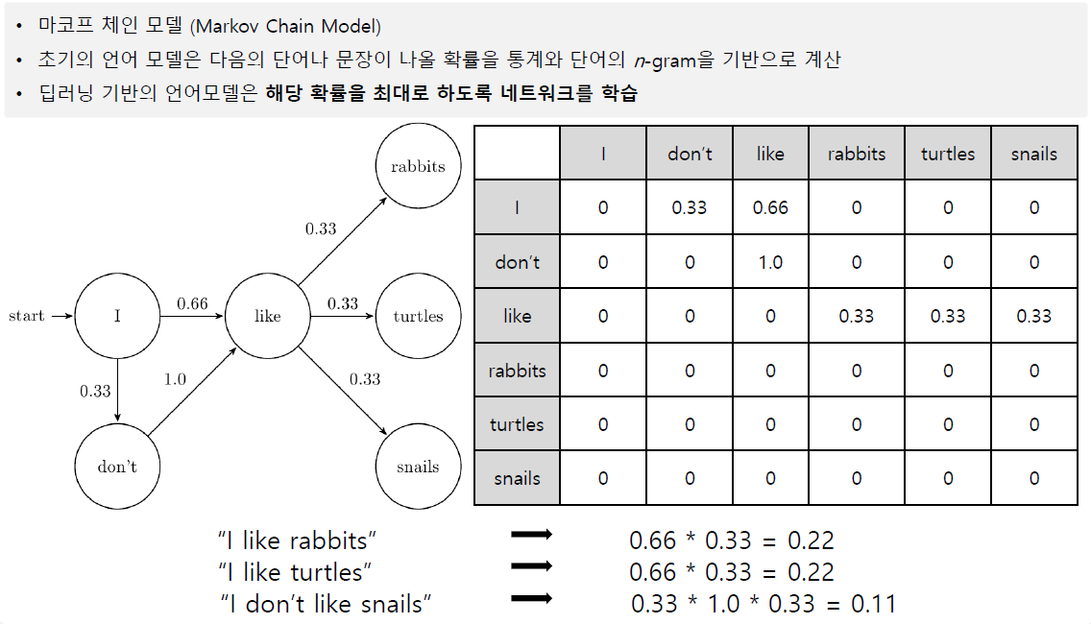
Part 1
Markov Chain Model 기반 언어모델

Slide 33
Part 2,
RNN
참고문헌 :
https://di-bigdata-study.tistory.com/23
Basics and Applications for Transformer, 이영재, 2020.9.4
딥러닝기반 자연어 언어모델 BERT, 김성현, 2019.8.8

Slide 34
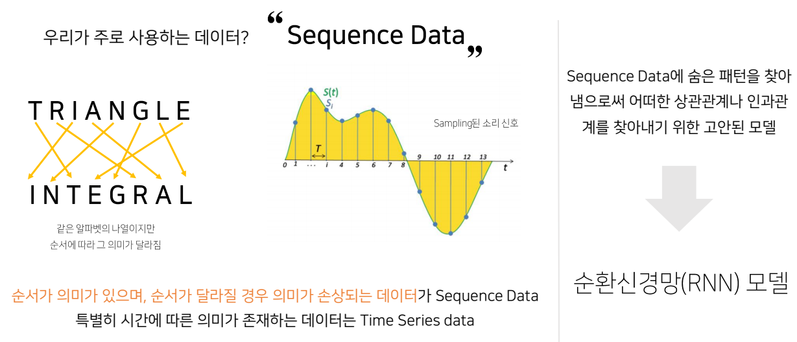
Part 2
순환 신경망

Slide 35
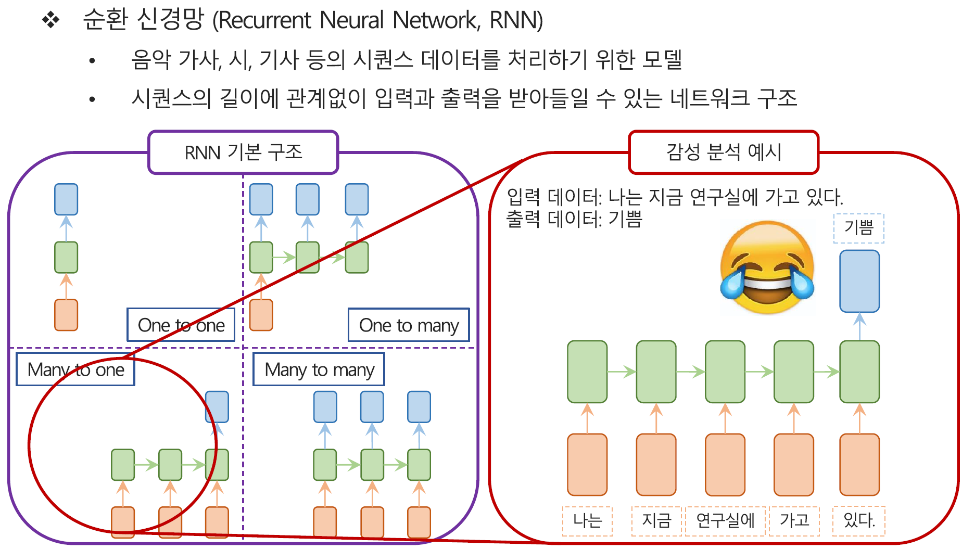
Part 2
순환 신경망

Slide 36
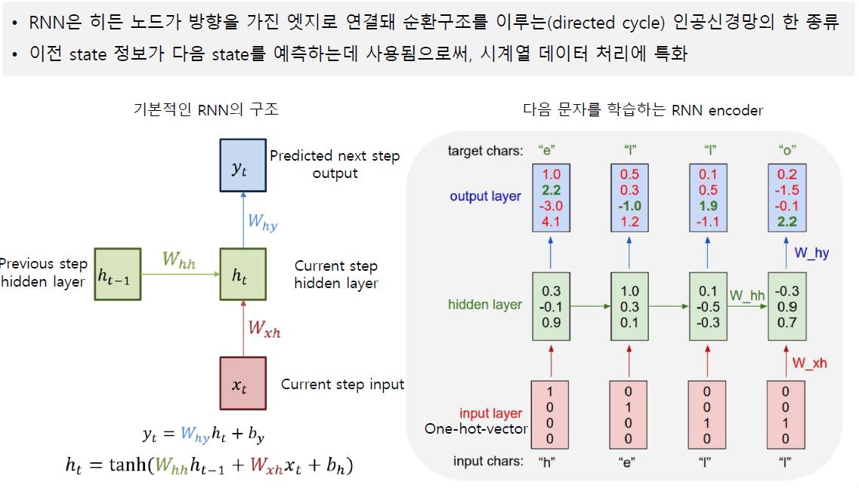
Part 2
Recurrent Neural Network 기반 언어모델
*RNN과 LSTM 을 이해해보자
https://ratsgo.github.io/natural%20language%20processing/2017/03/09/rnnlstm/

Slide 37
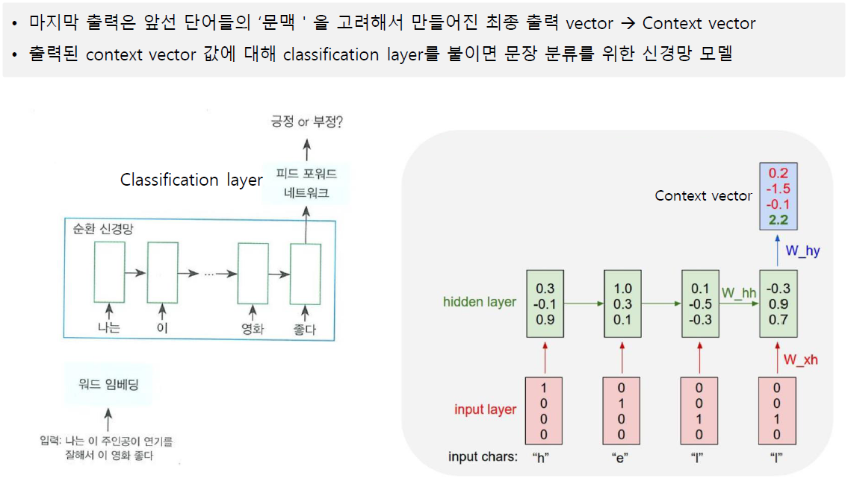
Part 2
RNN 언어모델을 이용한 Application
http://www.kyobobook.co.kr/product/detailViewKor.laf?ejkGb=KOR&mallGb=KOR&barcode=9791158391379&orderClick=LAG&Kc=

Slide 38
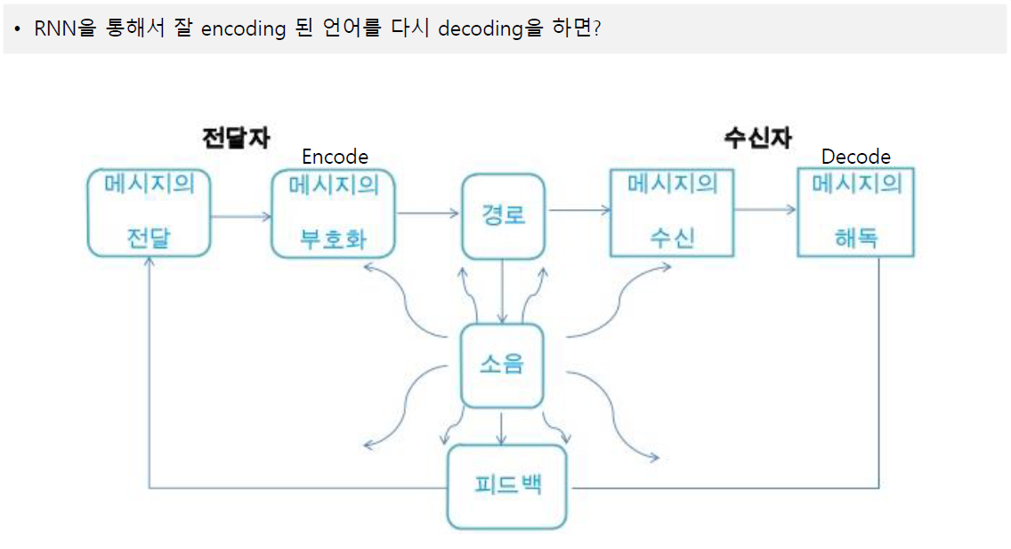
Part 2
Encoder - Decoder

Slide 39
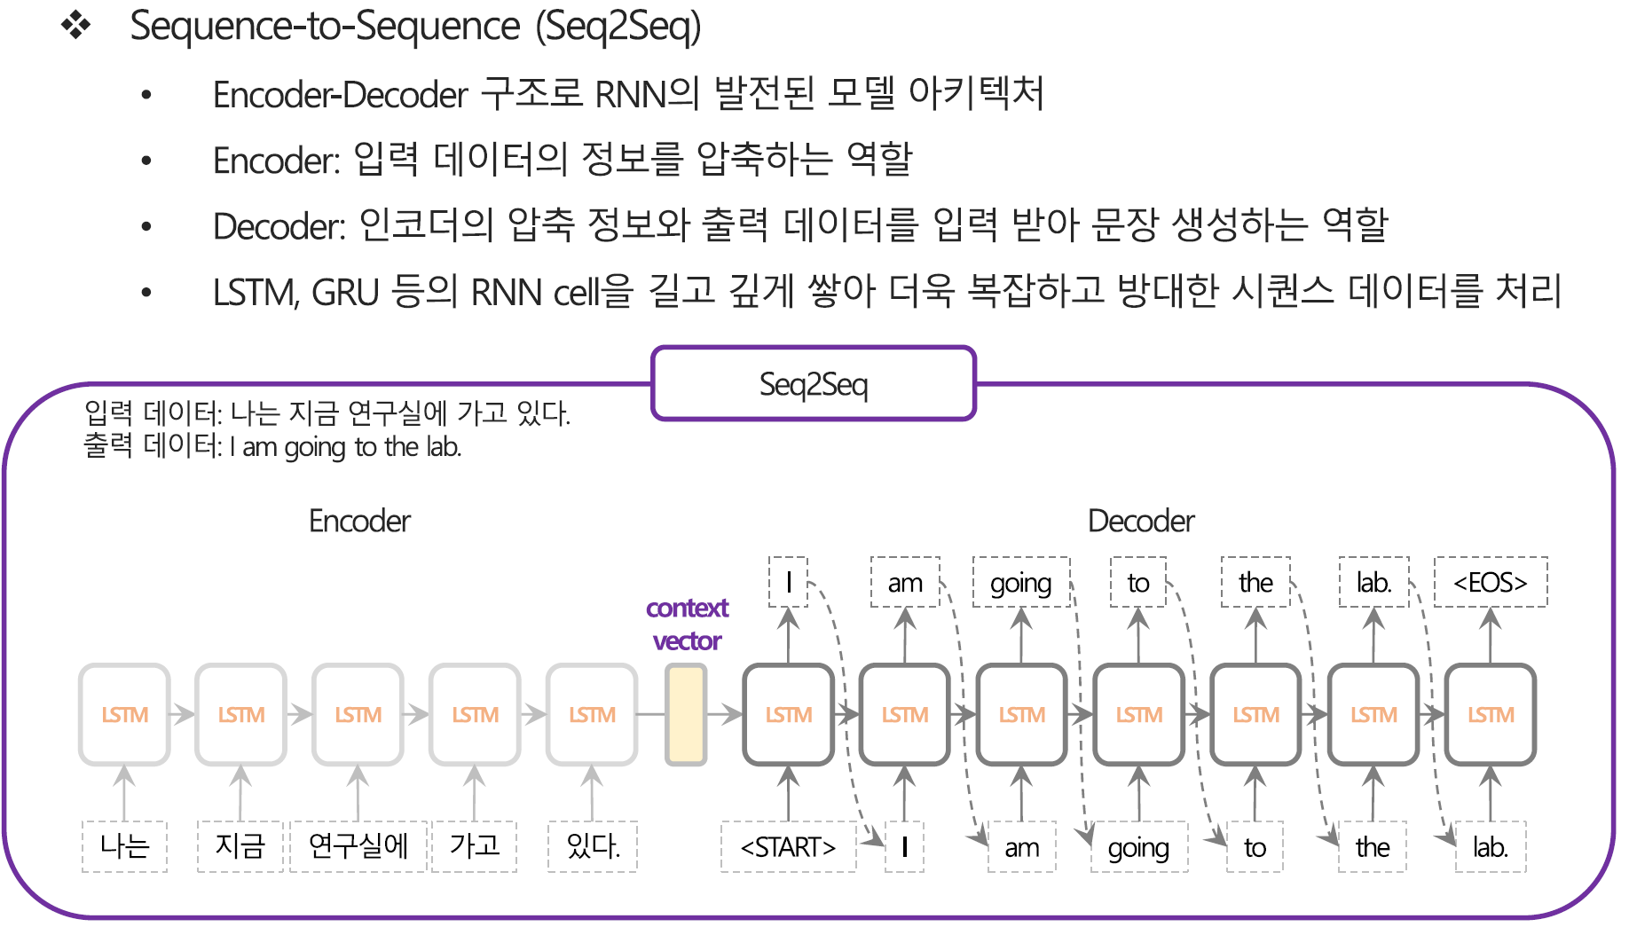
Part 2
Seq2Seq
획득된 Context vector 를 입력으로 출력을 예측
RNN 구조를 통해 Context vector 를 획득

Slide 40
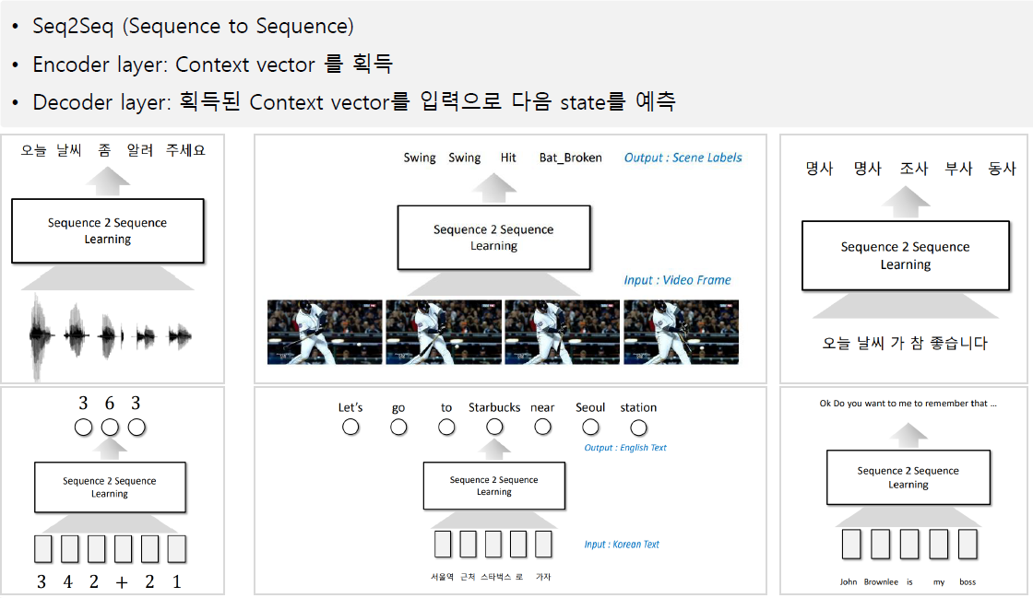
Part 2
Seq2Seq
https://tacademy.skplanet.com/live/player/onlineLectureDetail.action?seq=123

Slide 41
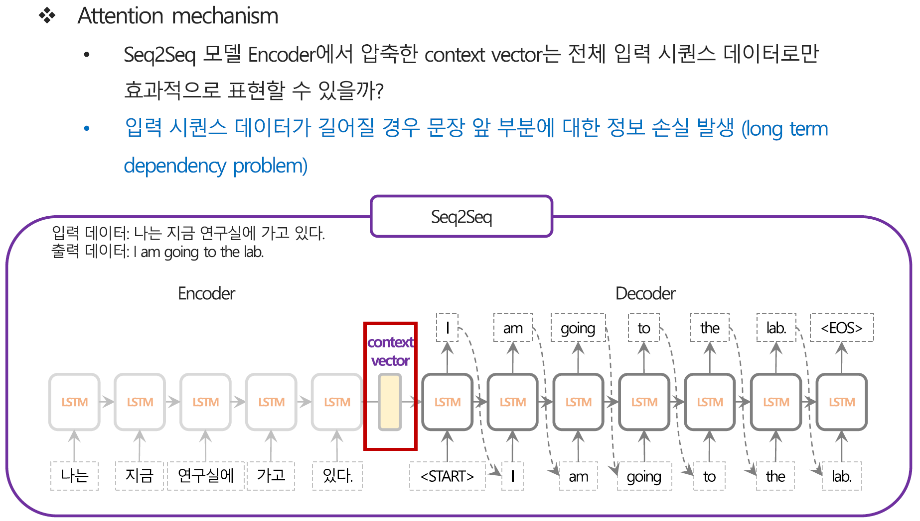
Part 2
Seq2Seq

Slide 42
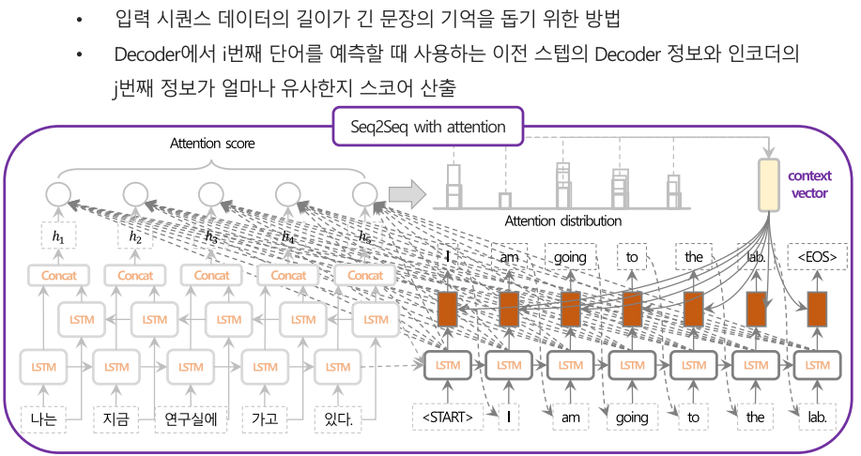
Part 2
Seq2Seq

Slide 43
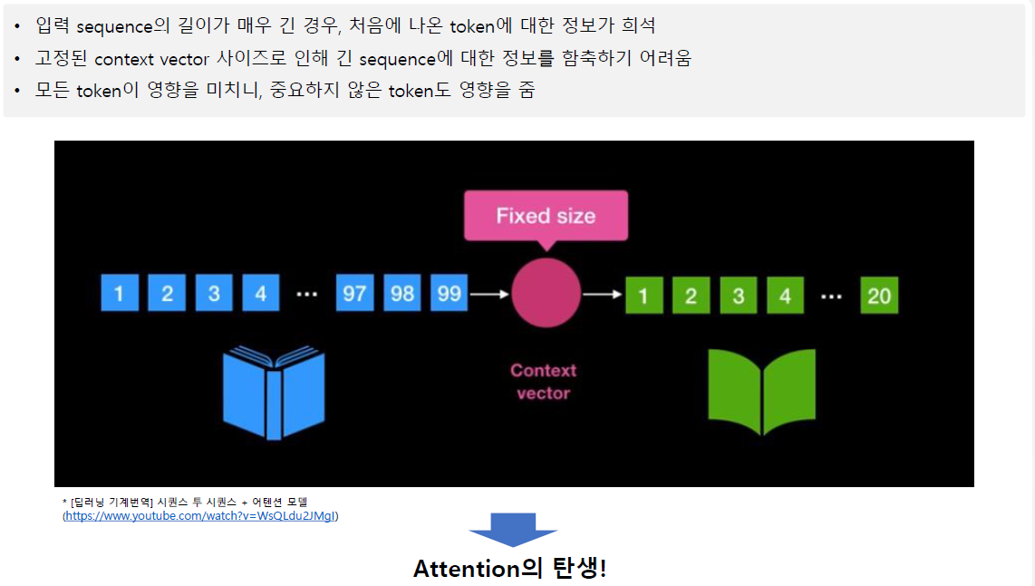
Part 2
Seq2Seq
https://www.youtube.com/watch?v=WsQLdu2JMgI

Slide 44
Part 3,
Attention
참고문헌 :
Basics and Applications for Transformer, 이영재, 2020.9.4
딥러닝기반 자연어 언어모델 BERT, 김성현, 2019.8.8

Slide 45
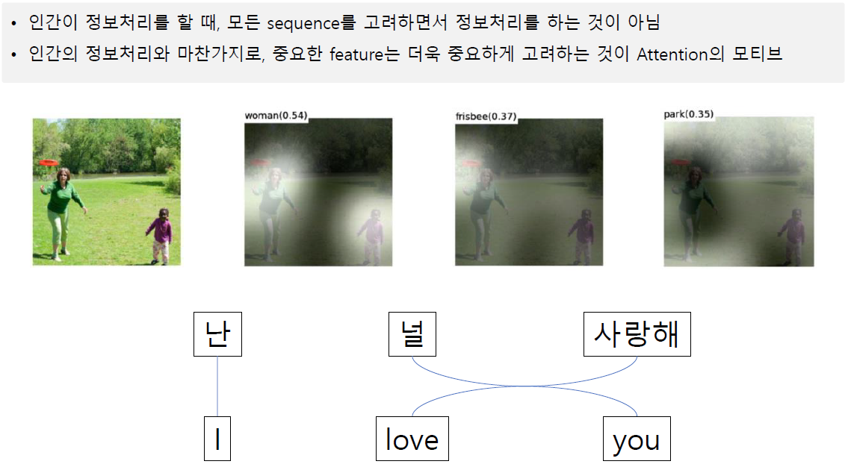
Part 3
Attention 모티브

Slide 46
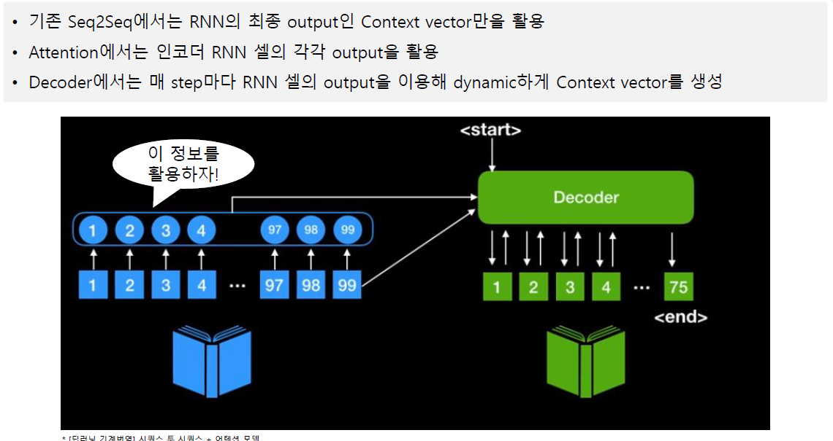
Part 3
Attention 모델
https://www.youtube.com/watch?v=WsQLdu2JMgI

Slide 47
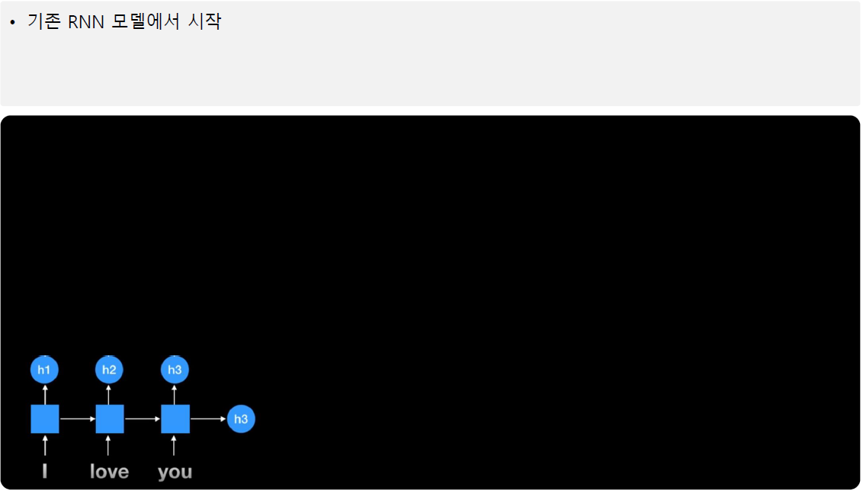
Part 3
Attention 모델
https://www.youtube.com/watch?v=WsQLdu2JMgI

Slide 48
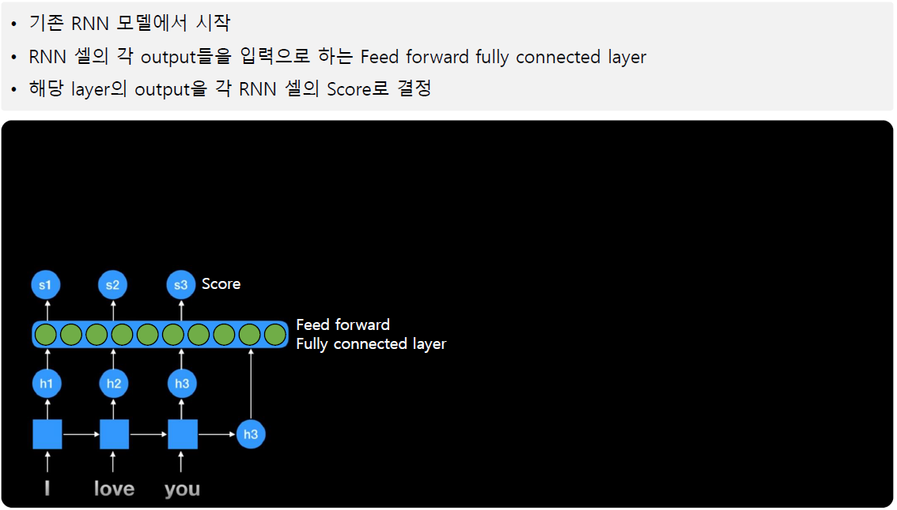
Part 3
Attention 모델
https://www.youtube.com/watch?v=WsQLdu2JMgI

Slide 49
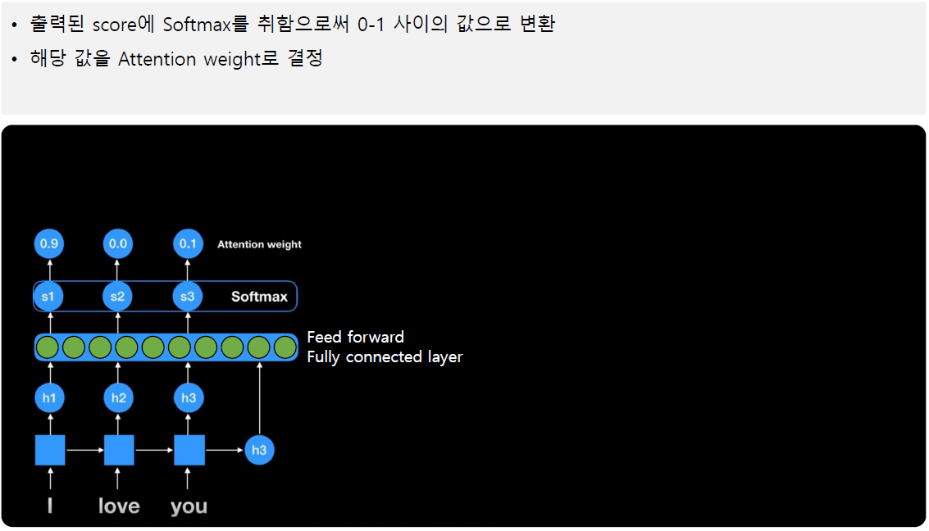
Part 3
Attention 모델
https://www.youtube.com/watch?v=WsQLdu2JMgI

Slide 50
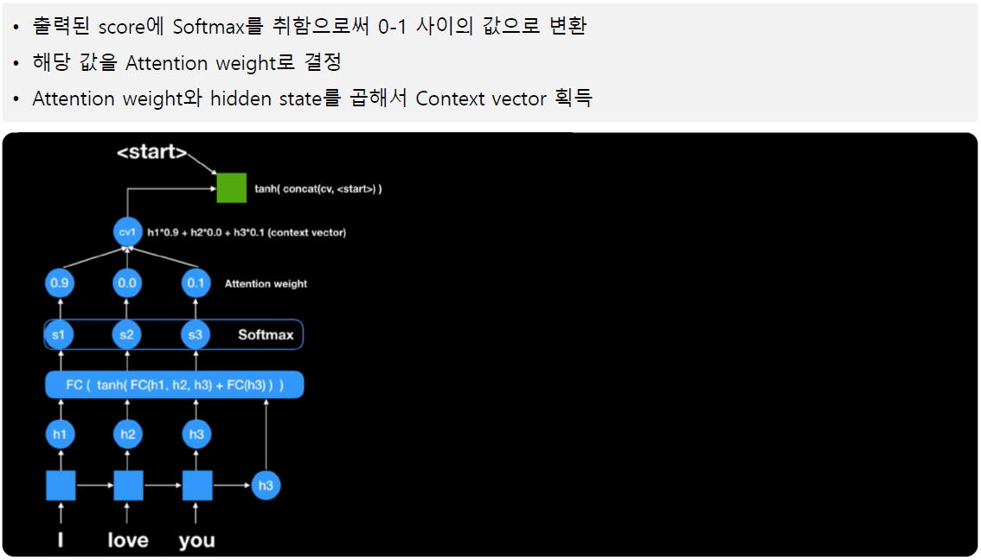
Part 3
Attention 모델
https://www.youtube.com/watch?v=WsQLdu2JMgI

Slide 51
Part 3
Attention 모델
https://www.youtube.com/watch?v=WsQLdu2JMgI

Slide 52
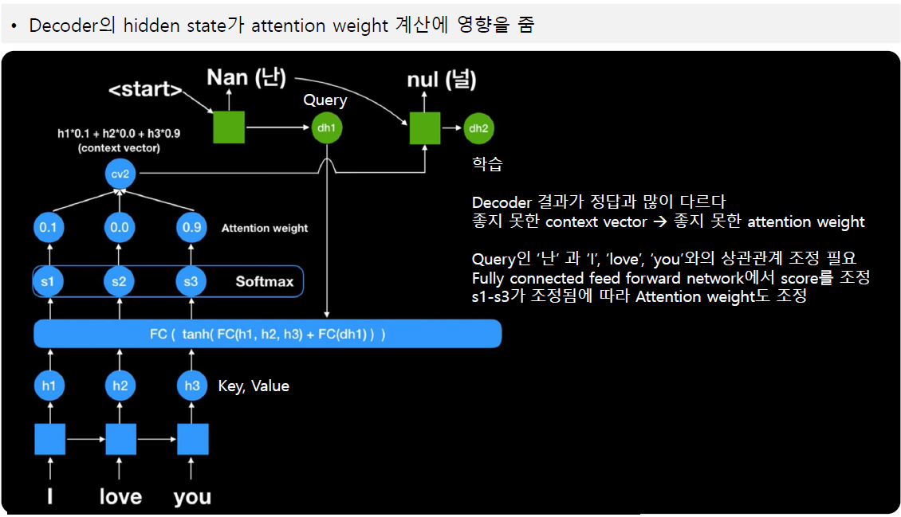
Part 3
Attention 모델
https://www.youtube.com/watch?v=WsQLdu2JMgI

Slide 53
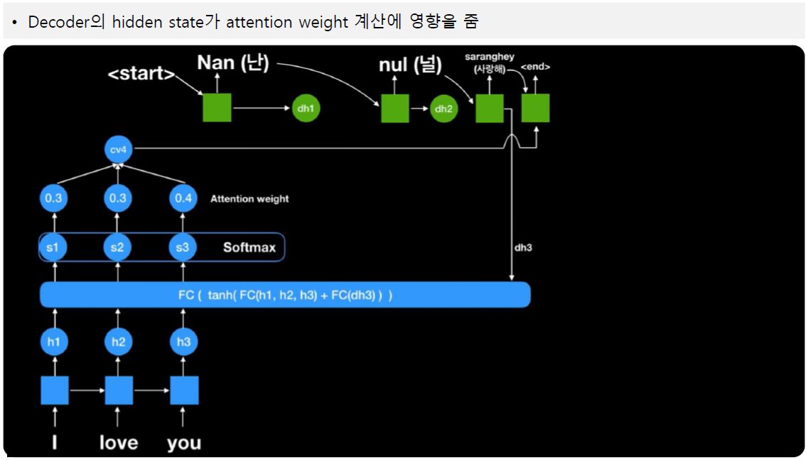
Part 3
Attention 모델
https://www.youtube.com/watch?v=WsQLdu2JMgI

Slide 54
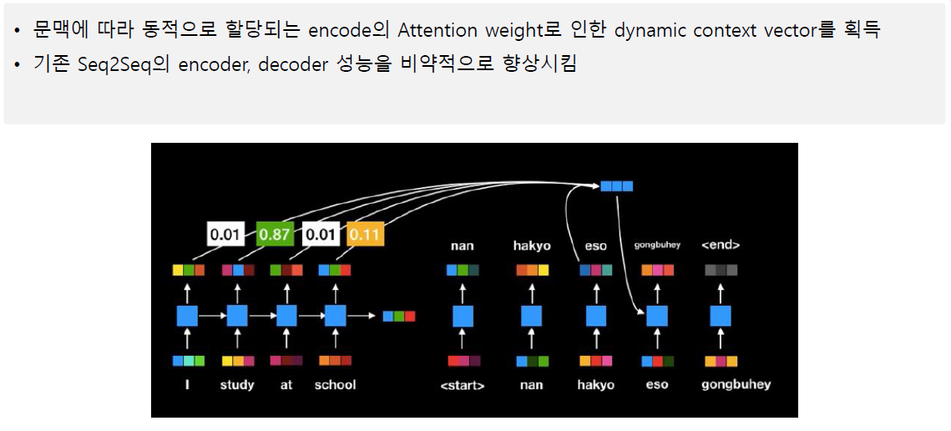
Part 3
Attention 모델
https://www.youtube.com/watch?v=WsQLdu2JMgI

Slide 55
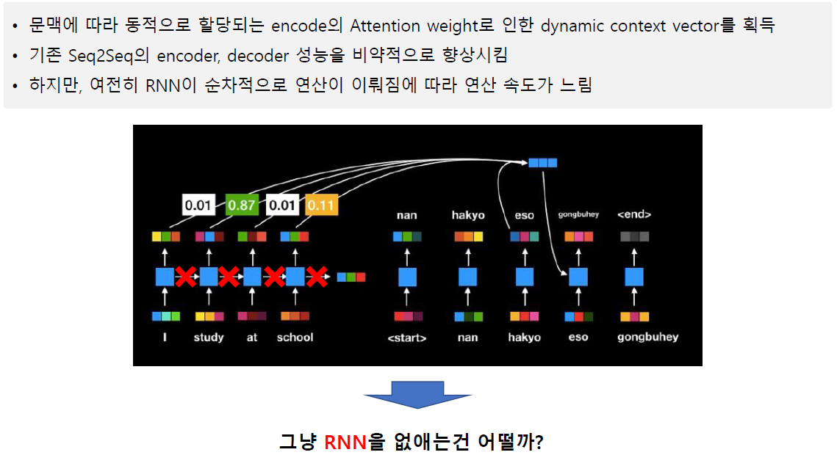
Part 3
Attention 모델
https://www.youtube.com/watch?v=WsQLdu2JMgI

Slide 56
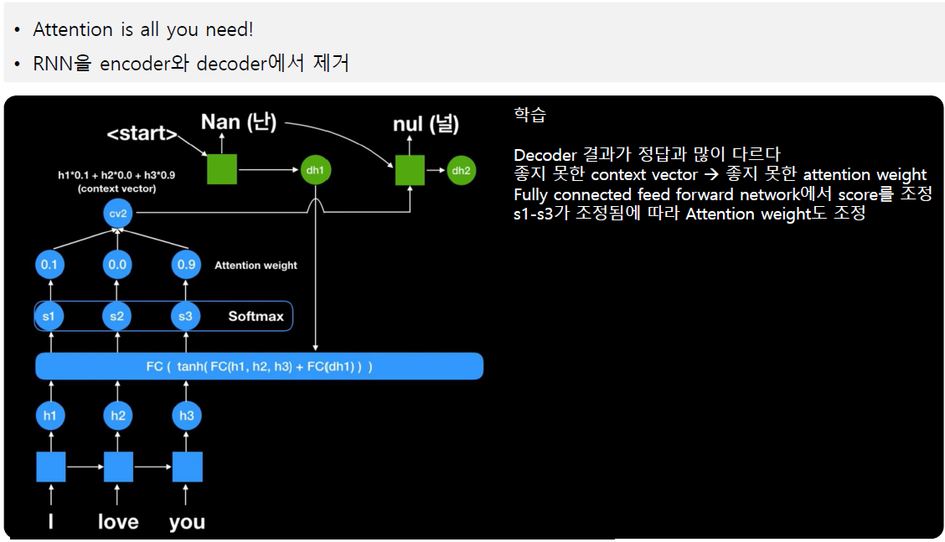
Part 3
Self-Attention 모델
https://www.youtube.com/watch?v=mxGCEWOxfe8

Slide 57

Part 3
Self-Attention 모델
https://www.youtube.com/watch?v=mxGCEWOxfe8

Slide 58

Part 3
Self-Attention 모델
https://www.youtube.com/watch?v=mxGCEWOxfe8

Slide 59

Part 3
Self-Attention 모델
https://www.youtube.com/watch?v=mxGCEWOxfe8

Slide 60

Part 3
Self-Attention 모델
https://www.youtube.com/watch?v=mxGCEWOxfe8

Slide 61

Part 3
Self-Attention 모델
https://www.youtube.com/watch?v=mxGCEWOxfe8

Slide 62

Part 3
Self-Attention 모델
https://www.youtube.com/watch?v=mxGCEWOxfe8

Slide 63

Part 3
Self-Attention 모델
https://www.youtube.com/watch?v=mxGCEWOxfe8

Slide 64

Part 3
Multi-head Self-Attention 모델
https://www.youtube.com/watch?v=mxGCEWOxfe8

Slide 65

Part 3
Multi-head Self-Attention encoder모델
https://www.youtube.com/watch?v=mxGCEWOxfe8

Slide 66
Part 4,
Transformer
참고문헌 :
Basics and Applications for Transformer, 이영재, 2020.9.4
딥러닝기반 자연어 언어모델 BERT, 김성현, 2019.8.8

Slide 67

Part 4
Transformer 개요

Slide 68

Part 4
Transformer 개요
https://www.youtube.com/watch?v=xhY7m8QVKjo

Slide 69

Part 4
Encoder - Decoder

Slide 70

Part 4
Transformer 구조

Slide 71

Part 4
Transformer 구조

Slide 72

Part 4
Transformer 구조

Slide 73

Part 4
Transformer 구조

Slide 74

Part 4
Transformer 구조

Slide 75

Part 4
Transformer 구조

Slide 76

Part 4
Transformer 구조

Slide 77

Part 4
Transformer 구조

Slide 78

Part 4
Transformer 구조

Slide 79

Part 4
Transformer 구조

Slide 80

Part 4
Transformer 구조

Slide 81

Part 4
Transformer 구조

Slide 82

Part 4
Transformer 구조

Slide 83

Part 4
Transformer 구조

Slide 84

Part 4
Transformer 구조

Slide 85

경청해주셔서 감사합니다.

